Slide 1
NHS Pensions June 2021

Slide 2
Background
NHS Workforce
1.6 million NHS workers in England and Wales
80% female
40% part time
Changes in life expectancy:
Male employees aged 60 in 1955 16.1% and 2006 30.1%
Female employees aged 60 in 1955 19.8% and 2006 31.8%
Notes:
40% part time workers are paying contributions based on WTE pay.
More people older still contributing to the NHS workforce
Interestingly, the most recent valuation demonstrated that life expectancy had fallen.

Slide 3
Background
Purpose of the scheme
To provide valuable and competitive and secure guaranteed retirement benefit for all those working in the NHS.
Recruit and retain staff.
Encourage return to work in the NHS
Support longer working.
Notes:
Still one of the best pension schemes
Part of the Benefit package working in the NHS.
Pension attracts people to work in the NHS and helps to keep them there to build up benefits-money in retirement and for the rest of your life. Protection for dependants as money is payable on scheme members death to spouse or dependants for the rest of their life. Ill health retirement if needed.
Longer working by building in flexibilities in relation to accessing pension and returning to work , step down, wind down or drawing down some Pension and continuing to work.
NHS workers: directly employed, medical, dental and ophthalmic practitioners and trainees, general medical practice staff, eligible staff of independent providers (WOS), eligible staff of independent providers who have been granted access to the scheme by the Secretary of state.

Slide 4

Auto enrolment
The NHS Pension Scheme is the default pension scheme for NHS workers to be automatically enrolled in under government efforts to increase levels of personal pension saving in the UK.
Membership of this Scheme is voluntary but if you are eligible you will be automatically enrolled and made a member from the day you start or restart in the NHS, unless you decide to opt out after joining
It is a defined benefit scheme and is open to NHS workers aged between 16 and 75.
Notes:
Defined benefit-promise to pay pension based on salary and length of service.

Slide 5
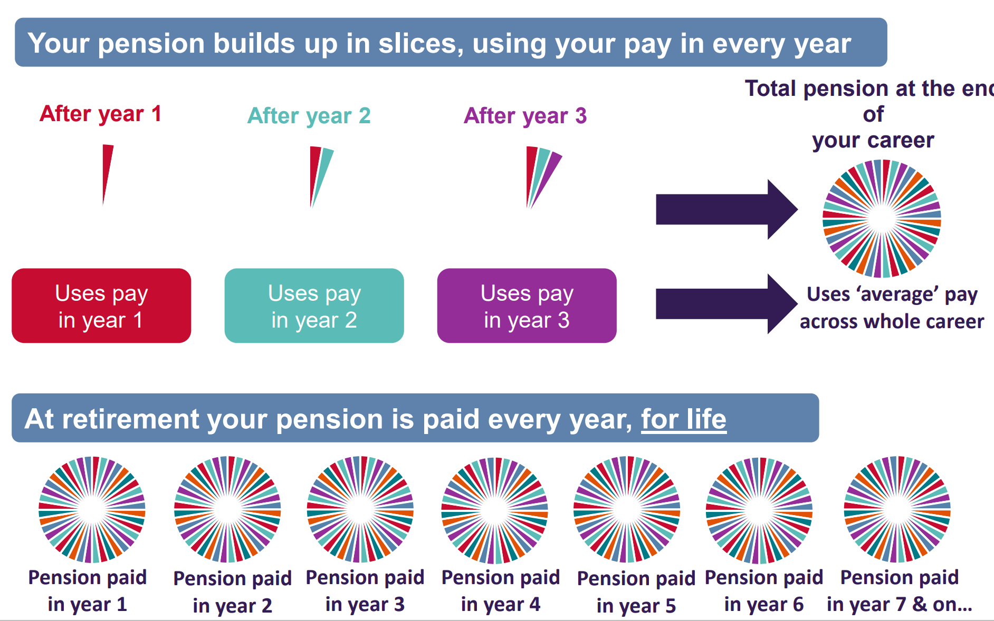
Overview of 2015 scheme
The 2015 Scheme is a Career Average Revalued Earnings (CARE) scheme. This is a form of defined benefit pension scheme, which means you get a guaranteed level of benefit at retirement payable according to a fixed formula.

Slide 6
How does my pension build up?
Build up rate /Accrual rate
In the 2015 scheme the build up rate is 1/54th, so you earn a pension each year of 1/54th of your pensionable earnings. For example, if you earn £18,000 in a year you would earn a pension for that year of 1/54th of £18,000, which is £333 (rounded down for illustration purposes only). This is the pension you would build up for that year.
Annual revaluation
Your pension earned each year will be increased each year by a rate, known as ‘revaluation’, in the period before you retire or leave

Slide 7
How does my pension build up cont.
Length of Scheme membership
You can continue to build up pension rights in this Scheme until age 75 with no limit to the number of years’ pensionable earnings that can be taken into account. The more years of membership you have then the greater number of annual pensions you will earn leading to a bigger overall pension
Pensionable earnings
Pensionable pay is the amount of pay pension contributions are based and paid on. Pay that is pensionable is your basic salary excluding overtime (in excess of whole time hours), one off bonuses, and expenses. Not everything that you earn is pensionable. The key to pensionable pay is ‘regular payments’. Pensionable pay should include regular payments such as unsocial hours allowance, London weighting and on-call availability allowance payments.

Slide 8
Costs and contributions
The cost of providing the NHS Pension Scheme is shared between members and employers.
Tiered member contributions 5% to 14.5% dependant on salary
Employer contributions (20.6% currently)
Member and Employee contributions used to pay benefits (excess paid to/shortfall paid by the Treasury)
Notes:
Get tax relief on Pension contributions-

Slide 9
Retirement
The Normal Pension Age is the age that you can retire from NHS employment and have your pension paid without reduction for early payment. In the 2015 Scheme, the Normal Pension Age is the same as the State Pension Age
You can calculate your state pension age by visiting: www.gov.uk/state-pension-age
Notes:
Currently if you were born after 1978 your normal pension age is 68

Slide 10
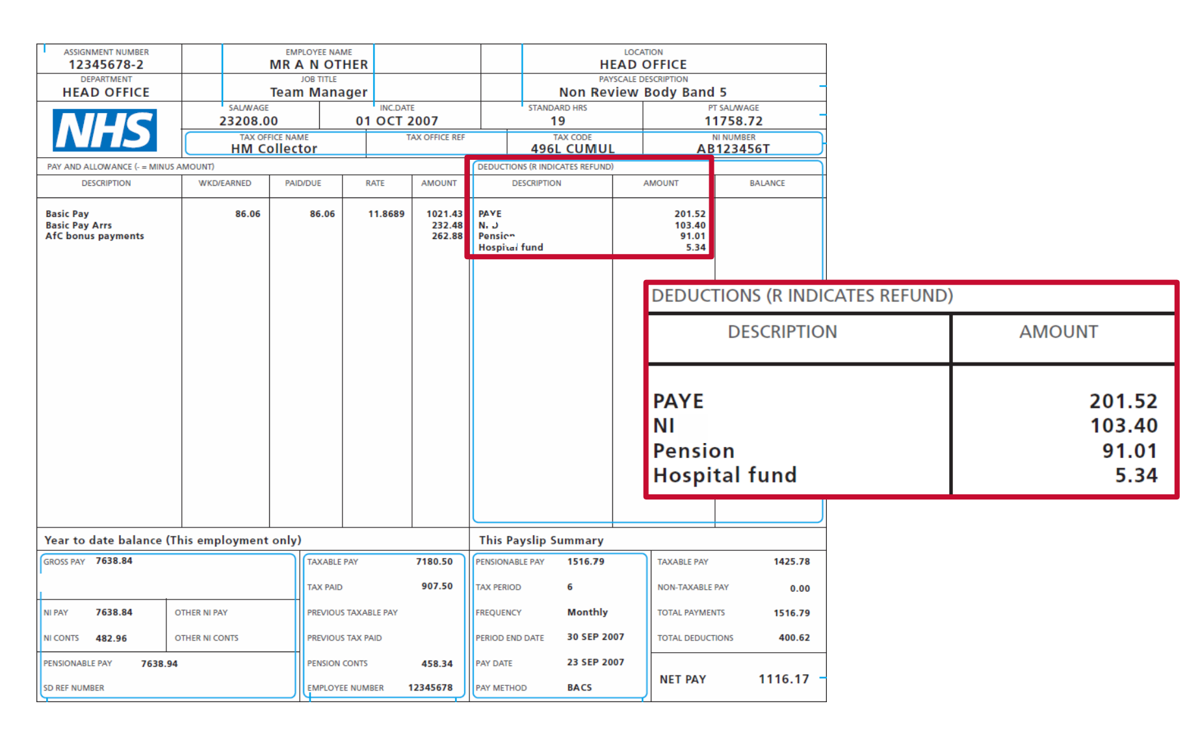
Your pay slip
Notes:
You also get tax relief when you pay into a pension meaning your income tax payments are lower

Slide 11
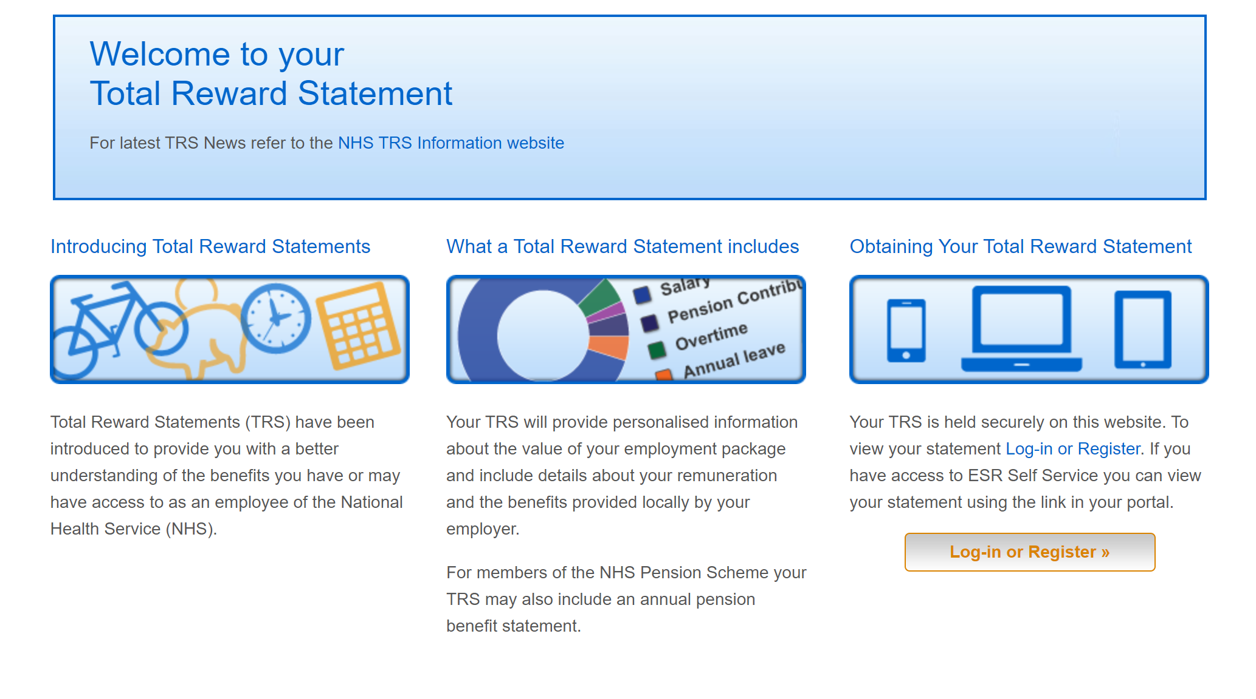
Total Reward Statement
Notes:
A Total Reward Statement summarises an individual employee’s employment package, including:
basic pay
allowances
pension benefits (for NHS Pension Scheme members)
Some NHS organisations also provide other benefits included in the statement, such as:
health and wellbeing programmes
learning and development
flexible working opportunities
childcare vouchers
cycle to work schemes
A small number of NHS staff instead of getting a Total Reward Statement will get an Annual Benefit Statement (ABS) instead this might be if your trust doesn’t use ESR or if you work for a GP surgery
You'll be able to access your statement online using the Total Reward Statement portal and ESR Employee Self-Service for organisations that use the facility.
Statements provide an overview of your pension benefits up to 31 March each year.
the statement is based on information provided to NHS Pensions by 31 May each year.
Statements are refreshed every year and are made available mid August.
The content shown is not ‘real-time’. NHS Pensions rely on NHS employers providing information by 31 May each year as a one-off annual update

Slide 12


For further information
Website: www.rcm.org.uk
Telephone: 0300 303 0444
Email: info@rcm.org.uk
www.facebook.com/midwivesRCM
@MidwivesRCM

