Slide 1
Promoting Positive Cultures -
Creating a Strong Team
Updated 10/2/20

Slide 2

Aim of this workshop
To support the team to take some time to think about what is working well and what is not working so well at the moment and to think about how the atmosphere, culture and approach to team working could be improved
We are going to start by taking the temperature…
And doing a brief team working exercise
Notes:
get the participants to fill in the ‘how positive is our culture’ form – this is to get those attending to ‘take the temperature of the culture in their maternity services at the moment’ – we did a four point smiley scale from very happy to very sad. We then propose to send the attendees out the form again three months after the training to see if they feel if the culture is any more positive.
We then do exercise with tent poles – about 6-8 people in rows either side of a tent pole – only able to balance it on their index fingers – have to work together to lower it to the ground. This is good laugh – they have to communicate and cooperate. Then ask for any observations?

Slide 3
If it is about NHS culture it is about leadership. (kings fund Blog)
There are plenty of issues to keep NHS leaders awake at night: financial concerns, the winter crisis, the junior doctors’ strikes and experiences of poor-quality care are all in the news. But what about some of the underlying issues behind the headlines?
NHS leaders are concerned about staff reporting high levels of bullying and harassment and are considering strategies to deal with this. They are also concerned with high levels of discrimination reported by some groups of staff and are considering strategies to deal with this.
And there need to be strategies to deal with high levels of staff stress and absenteeism. And then the ambition for the NHS to be the largest learning organisation in the world requires a strategy for ensuring continuous improvement. And there is a need to develop system leadership, which will require yet more strategies. Plus the need to address the shortage of leaders throughout the NHS, which requires a further strategy. So what we end up with is a patchwork of strategies, sewn more or less together in a diffuse set of responses to these important concerns.

Slide 4
If it is about NHS culture it is about leadership. (kings fund Blog)
If we want to deal effectively with all these issues, then, first and foremost, we need to develop organisations with cultures that deliver high-quality, continually improving and compassionate care. Research shows that such cultures are sustained by organisations that have:
an unwavering commitment to providing safe, high-quality care
a commitment to effective, efficient, high-quality performance
behaviours characterised by support, compassion and inclusion for all patients and staff
ways of working that focus on continuous learning, quality improvement and innovation
enthusiastic co-operation, teamworking and support within and across boundaries.

Slide 5
Plan for today
Why are we here?
What are the behaviours that make up a negative work culture?
What are we contributing to the culture where we work?
How can we tackle negative behaviours?
What do we want to do as a team to improve the culture?

Slide 6

Which characteristics are fundamental to a healthy culture?
Inspiring vision and values
Goals and performance
Support and compassion
Learning and innovation
Effective teamwork
Collective leadership

Slide 7
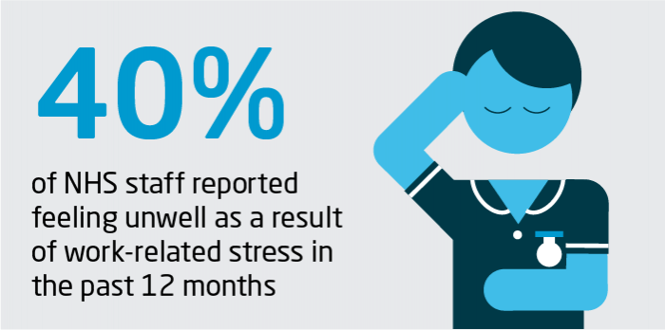
NHS leadership and culture
Source: NHS England 2019
NHS hospital, mental health and community providers in England are reporting a shortage of almost 100,000 staff, representing one in eleven posts; projections suggest this gap could reach almost 250,000 by 2030 if current trends hold.
13 per cent of NHS staff experienced bullying or harassment from managers in the previous year while 19 per cent experienced it from other colleagues.
NHS leadership and culture | The King's Fund
Collaborative, inclusive and compassionate leadership is essential to deliver the highest quality care for patients and tackle deep-seated cultural issues in the NHS, including unacceptable levels of work-related stress, bullying and discrimination.

Slide 8
NHS CORE VALUES
Respect and dignity
We value each person as an individual, respect their aspirations and commitments in life, and seek to understand their priorities, needs, abilities and limits. We take what others have to say seriously. We are honest about our point of view and what we can and cannot do.
Commitment to quality of care
We earn the trust placed in us by insisting on quality and striving to get the basics right every time: safety, confidentiality, professional and managerial integrity, accountability, dependable service and good communication. We welcome feedback, learn from our mistakes and build on our successes.
Compassion
We respond with humanity and kindness to each person’s pain, distress, anxiety or need. We search for the things we can do, however small, to give comfort and relieve suffering. We find time for those we serve and work alongside. We do not wait to be asked, because we care.

Slide 9
NHS CORE VALUES
Improving lives
We strive to improve health and well-being and people’s experiences of the NHS. We value excellence and professionalism wherever we find it – in the everyday things that make people’s lives better as much as in clinical practice, service improvements and innovation.
Working together for patients
We put patients first in everything we do, by reaching out to staff, patients, carers, families, communities, and professionals outside the NHS. We put the needs of patients and communities before organisational boundaries.
Everyone counts
We use our resources for the benefit of the whole community, and make sure nobody is excluded or left behind. We accept that some people need more help, that difficult decisions have to be taken – and that when we waste resources we waste others’ opportunities. We recognise that we all have a part to play in making ourselves and our communities healthier.

Slide 10
What does our culture look like – Nationally – for early career midwives. SCOTLAND
The RCM Scotland First Five Years Forum (FFYF) survey 2019
Of the 136 respondents, 54% identified that they had a preceptorship programme in place in the first year, while 46% had no structured programme.
62% of midwives felt that a structured preceptorship would have influenced where they chose to work. While 35% felt that it would not influence how they chose their place of work
The support available to new midwives in Scotland was mixed, only 24% of the respondents had a named preceptor and 46% had an orientation to the unit they were working on.
17% felt totally unsupported in their first year, and over half felt unsupported some of the time (52%).
More than half of those who responded thought about leaving the profession in their first year – with lack of support as the key reason
Notes:
Forum set up in 2018 for NQMs between 1-5yrs qualified
Approx. 25 NQMs from across Scotland
Initial work of the forum looked at support for NQMs in their first year of qualifying. Conducted a survey asking NQMs about their experiences;

Slide 11
What early career midwives in Scotland said about their first year…
“Like, that is when all the learning as a student finally fell into place. I learned so much in my first few months as a newly qualified midwife”
“Well supported, consolidating my knowledge and clinical skills, building my confidence with decision making and care plans”
“Overwhelmed”
“I felt stressed, unsupported, overwhelmed, petrified and constantly in fear of making a mistake”
“Totally out my depth. Felt sick every day often contemplated leaving. Real effect on my confidence.”
“A huge jump from being a student to being qualified”
“Highs and lows – great getting experience and growing in confidence but at points did feel out of my depth”

Slide 12
FFYF – How supporting NQMs leads to improved workplace cultures
New Zealand
Introduced in 2007, the programme provides a structured approach to support the NQM in the first year post qualification, funding a clinical mentor midwife chosen by the NQM, financial assistance for education and mandatory inclusion of the NQM in an assessment and reflection process at the end of the year.
The MYFP programme was found to be successful, with midwifery council data showing a 10% increase in retention of midwives from 89% in 2005 (prior to implementation) to 98% in 2008 (midwifery council of New Zealand, 2010).
The majority of participants in the study described the programme as holistic, flexible and tailored to the individual, and support from their clinical mentors and other colleagues and financial support for education as the main factors in contributing to the development of their own professional confidence.
A further study on effect of the implementation of the MYFP programme on changing culture within the midwifery workplace. Identified a positive impact on the midwifery culture, with midwives New Zealand taking greater collective responsibility for NQMs coming into practice with them, suggesting that the programme had fostered a culture of nurturing new midwives within their role.
A study New Zealand evaluated the effectiveness of their nationally implemented ‘midwifery first year of practice’ (MFYP) programme.

Slide 13
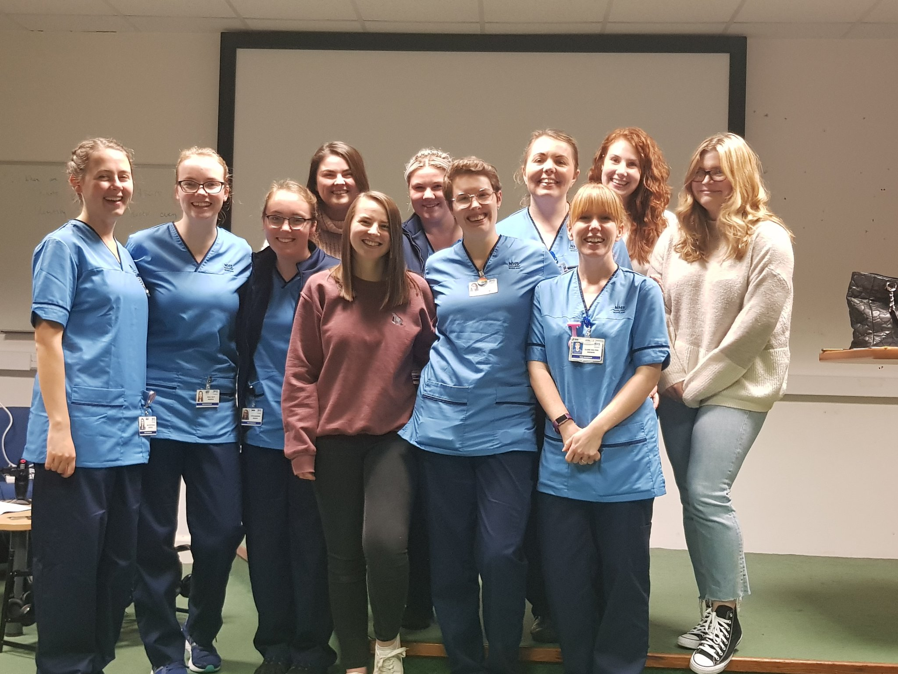
What does our culture look like
Connect 5 set up by Siobhan Leith, Community Midwife in Grampian. Support from management and enthusiasm from NQMs for a support network.
“I have heard of some midwives who are less willing to support new initiatives / appreciate a meaningful supportive relationship with NGM, with the mind set of 'I didn't get this so why should anyone else”
“Changing workplace culture, a lot more positive, supportive. Notice a big change from being a student in AMH’”
“Culture feels like its shifting. Still some old school mentalities that aren't as welcoming BUT nearly all staff welcome new starts with lots of support and opportunities to learn”
“Beginning to notice a shift towards a more positive culture in some staff. Still a long way to come but its improving”

Slide 14
Building a more supportive culture locally
The What Matters to Me/Caring for You project is a programme of staff engagement designed to:
Promote an organisational culture where all staff feel it is safe to raise concerns and become empowered.
Link the expectations of the patient and service user with the aspirations of midwives and service providers in a healthy and safe work environment.
Develop the evidence base for improving the staff and patient experience, transform the organisational culture using the Trust’s Values and Behaviours framework and to link related workstreams in a way that uses precious time effectively, efficiently and engages all grades and specialties of staff.
Link related workstreams in a way that uses staff time effectively and efficiently and engages all grades and specialties.
Notes:
Manchester foundation trust – Develop what matters to me. Regular staff surveys are sent out to staff to see if there are trends developing in workplace cultures. These are then addressed at a local level.

Slide 15
Building a more supportive culture locally
Meet the MFT Strategic Aim of developing our organisation, supporting the health and wellbeing of our workforce and enabling each member of our staff to reach their full potential.
In order to increase staff morale and motivation, they have:
Established a range of ‘What matters to you’ staff forums facilitated by senior staff.
Asked staff to complete ‘What Matters to You’ staff engagement proformas.
Notes:
Manchester foundation trust – Develop what matters to me. Regular staff surveys are sent out to staff to see if there are trends developing in workplace cultures. These are then addressed at a local level.

Slide 16
What is ‘workplace culture’?
Workplace culture is about how staff feel the night before a shift, how they feel when they leave work –
Do they feel they have made a difference? Do they feel worried about who is going to be in charge or on shift with them?
Workplace culture is about how problems are dealt with –
When something goes wrong do we look for someone to blame or do we look at what we can do to improve things?
Workplace culture is about how we respond to the need to change –
Do we all accept that change is always happening, do we moan about it or think about how we can contribute to shaping the change for the better?
Workplace culture is about everyone feeling accountable –
A culture is not just created by the management/leadership team – it is every one of us, every day, in every interaction
Workplace culture is about everyone feeling part of the team and knowing their contribution is valued
Notes:
Tracy – to set the scene https://www.campaignlive.co.uk/article/workplace-culture/1594941

Slide 17
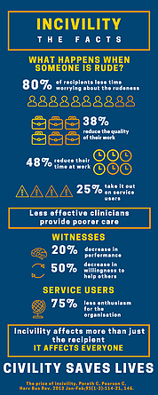
Incivility in the workplace
https://www.ted.com/talks/christine_porath_why_being_respectful_to_your_coworkers_is_good_for_business/transcript#t-2755
https://www.youtube.com/watch?v=S1EDatTYMkE
Incivility
Undermining
Bullying and harassment
Notes:
Tracy – We are now going to look at key elements of a negative culture – incivility (impoliteness, a lack of kindness) is a precursor to other negative behaviours – undermining and bullying and harassment. These are two films – one American Ted talk, one NHS one – they are each 14 minutes – so I think its worth deciding which one you want to show.

Slide 18
Civility Saves Lives
What happens when someone is rude to me?
The quality of my work reduces
When I see someone being rude?
I am less likely to help others too
When my patient sees rudeness?
The feel anxious about all the staff
When I allow rudeness?
All my patients suffer.
https://www.civilitysaveslives.com/
Notes:
Over the past year more evidence has been coming to light about CIVILITY and why being civil matters in the work environment. Civil work environments reduce errors, reduce stress and foster excellence.

Slide 19
Undermining – describes behaviour that has undermined professional confidence and/or self esteem
Examples of undermining behaviours
Being unwelcoming
Treating some colleagues differently from others – different tone of voice
Harassment - including inappropriate jokes and banter
Threatening – physical or emotional
Gossiping and spreading rumours
Negative and non-constructive feedback
Blocking professional development
Criticism of skills in front of others or public telling off
Disagreement on action plans in front of patients / women and families
Notes:
Tracy
There are clearly differences in opinions as to what is classed as discrimination, bullying, harassment and undermining ACAS publication provides some guidance on this
Intimidating behaviour includes ridiculing, withholding information, excluding, marginalising, micromanaging

Slide 20
What is bullying
Bullying is viewed as unreasonable behaviour that creates risk to the physical or mental health or safety of an individual.
This behaviour maybe characterised as offensive, intimidating, malicious or insulting, or it may be abuse or misuse of power through means that undermine, humiliate or intimidate an individual.
It is behaviour that is repeated over time or occurs as part of a pattern of behaviour. A one off abrupt comment is not bullying. These behaviours are identified by the effect they have , not the intention of the perpetrator.
Examples – unfair or unjust treatment, intimidation, derogatory or abusive interactions, denying training or promotion opportunities, spreading malicious rumours
PRECURSORS to bullying – Incivility, rudeness, disregard for others, disrespect
Some practices in the workplace may seem unfair but will not necessarily amount to bullying.
Is it bullying or just challenging?
Notes:
T
Kate Grimes – a life coach said that bullying is an entirely normal human behaviour, research had demonstrated that when people feel powerful, they tend to misuse it. She acknowledged that everyone with power engages in bullying behaviour to some extent, even if they don’t intend it.
NHS has a huge hierarchical structure, potentially every member of staff has some kind of power over another member of staff from Band 2 to CEO. Even within band levels if one has been there longer than the others.
Is it bullying – can excuse someone having a bad day if they are self aware and recognise being off that day, if they apologise for behaviour, however if it persistently makes you feel intimidated, reluctant to contribute or inadequate, it constitutes bullying

Slide 21
Harassment
Harassment
is defined as “unwanted conduct related to a relevant protected characteristic, which has the purpose or effect of violating an individual’s dignity or creating an intimidating, hostile, degrading, humiliating or offensive environment for that individual. Equality Act 2010
Examples
Negatively highlighting an individual’s physical disability
Derogatory comments about an individual’s beliefs
Unwelcome conduct of a sexual nature
Protected characteristics
Age Sex
Disability Sexual orientation
Gender reassignment Marriage or civil partnership
Race Pregnancy or maternity
Religion or belief
Notes:
Tracy
Worth noting Bullying itself is not against the law, but harassment is

Slide 22
Effects of Bullying/Undermining Behaviours
An unsupportive organisational culture leads to acceptance of inappropriate behaviours, the failure to hold people accountable and deterioration of teamwork
Bullying and undermining behaviours and patient safety are connected
Affects care and outcomes for women
Affects staff/teams and service provision
Higher sickness rates
Costs the NHS ££££ in lost working days
Careers are ended

Slide 23

That is what poor culture is and its impact – but what can we do about it?
Notes:
Mary

Slide 24
Maben 2013 research, 8 case studies in 4 trusts, including a maternity service
In conclusion, seven staff variables were identified as to be directly linked to good patient-reported experience:
Good local (team)/work and group climate.
Perceived organisational support.
High levels of co-worker support.
Low emotional exhaustion.
Good job satisfaction.
Supervisor support.
Good organisational climate
Notes:
Mary – looking at the evidence to help us understand why this is so important – there is a very close connection between user feedback and culture. If you want to have a really positive impact on patient experience, it is good to start by looking at team culture and improving that – Richard Branson – ‘look after your staff and they will look after the customers for you’

Slide 25
Supportive Teams
Attention needs to be given to the nature and quality of the team environment. In particular, attention should be focused on three crucial aspects:
the extent to which staff feel involved in decisions about the way the team works and their working environment;
how much control staff members have over their working patterns;
staff ability to manage demand.
Notes:
so we need to have enough staff in the system to cope – its no use just trying to get people to be kinder, happier, calmer, if you don’t have the right staffing levels. That is what the RCM lobby for – and we will continue to do that. When people are having to work beyond capacity, it is much more likely that there will be negative behaviours

Slide 26

What can we do to reduce poor workplace cultures?
Think about the causes of poor behaviours:
Poor staffing, high workload
Tiredness, hunger and thirst
Stress
Fear
Feeling undermined, bullied, excluded
https://www.rcm.org.uk/supporting/getting-help/caring-for-you/

Slide 27
Self Awareness
Self reflection
Do you stop and think about how you’ve behaved that day?
Do you listen to other members of your team?
Do staff come to you with ideas or suggestions?
Does your sense of humour involve jokes that could be racist, sexist or homophobic?
Do you use your position to offer mentorship or do staff go to others for this?
Do you apologise if you lose your temper?
Have you said derogatory comments about someone to another member of staff?
Do you blame others for problems that occur?
Do people speak freely in your area/at meetings or do you dictate how people behave?
Have you ever fired off an angry email?
Do you prefer to email colleagues about difficult situations rather than discuss things face to face
Notes:
Most visited section on RCOG website
Bullying can happen anywhere and anyone of us can be guilty. Think about your behaviour daily, think about your use of language, how you communicate to others. Its so easy for behaviour to change without us noticing

Slide 28
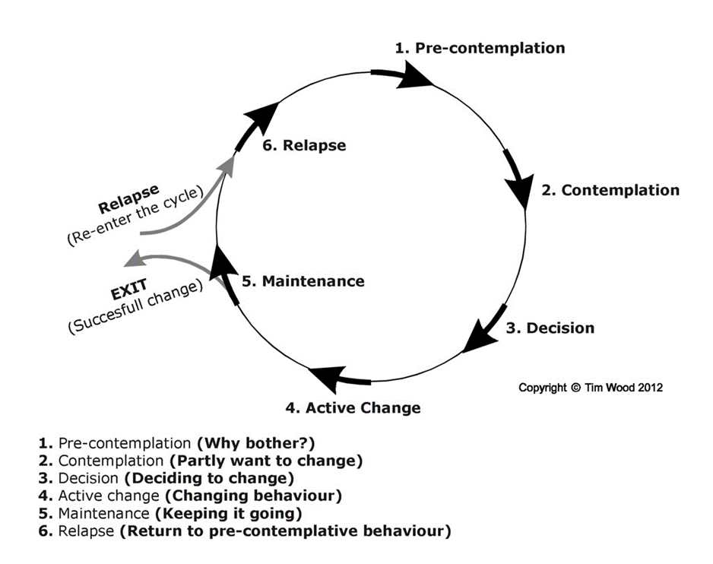
Using a behaviour change approach to improve civility in the workplace
Notes:
using a behaviour change approach – self audit approach and making a commitment to do something differently
I remind the midwives how they use behaviour change approaches with women to help them make positive lifestyle changes – eg being more active, eating more healthily, giving up smoking etc. We know that it is really helpful if we are wanting to make a lifestyle change for us to be honest about where we are at – eg doing an eating diary/Drinkaware app etc – this helps us know where we are at, and what changes we can make for the better.

Slide 29

Exercise – self awareness and evaluation
Notes:
hand out the self evaluation questionnaire (attached separately. Then give each of them an A4 sheet of paper and a pen – they then need to draw round their hand. Then they are going to write on or by each finger 5 simple actions that they are going to take over the next week at work to ‘lift up’ their colleagues and team. E.g – saying hello to everyone; giving everyone a cup of tea or another drink at 10am or 10pm; thanking a colleague for something great they did on that shift.
I then draw a big hand on a flip chart paper at the front and get them to give me 5 of their examples and write them on the big hand, so this gives others ideas.

Slide 30
Are you being bullied?
You are avoiding a colleague as you know they will make derogatory remarks about you?
You feel targeted by one individual and the rest of the team do not support you when that individual is present.
You feel too scared or intimidated to contribute to a discussion or raise a question.
You notice a team member uses an unpleasant or different tone of voice when speaking to you.
Your team is not functioning well and the behaviour of one or more individuals to others in the team is contributing to the problem.
When someone in the team often raises their voice or uses bad language such that the team try to avoid triggering such behaviour, this can lead to concealment and subsequent patient safety issues.
You are treated differently from other members of the team.
You are given “crap” off duty, requests persistently not honoured.
You find yourself treating others badly having learnt this pattern of behaviour.
Notes:
Are you witnessing a colleague in this situation?
If you find yourself treating others badly, so you are not proud of how you behaved, you may have learnt this pattern of behaviour from the way you have been treated.
What to do if you feel you are being bullied – ask to speak to a trusted colleague, speak to your manager, speak to your union rep

Slide 31
Research Evidence:
The most common forms of ‘lateral violence’ in nursing
Backstabbing
Nonverbal innuendo (raising eyebrows, face making)
Undermining activities (turning away, not available)
Verbal affront (covert or overt, snide remarks, lack of openness, abrupt responses)
Withholding information (practice or patient)
Sabotage (deliberately setting up a negative situation)
Broken confidences
Failure to respect privacy
Griffin, 2004
Notes:
this is a good bit of research done by Griffin with student nurses – the ones at the top of the triangle are the most common behaviours displayed and the ‘broken confidences’ at the bottom are the least common. I will attach the research article.

Slide 32
Research – The benefits of ‘Cognitive rehearsal’ and cue cards
Nonverbal innuendo –
I sense (or I see from your facial expression) that there may be something you wanted to say to me. Its okay to speak directly to me
Verbal affront/ Undermining activities
Help me understand how this situation may have arisen? Is there a way we can better respond to a situation like this?
Withholding information
It is my understanding that there is more information available regarding this situation
Infighting /bickering in public
This is not the time or place. Physically walk away or move to a neutral spot
Backstabbing
I don’t feel right talking about him/her without them being here – have you spoken to him/her?
Notes:
Griffin, the researcher, got the student nurses to write down possible responses to the negative bullying behaviours that they might experience on the ward. She then got them to practice saying them and to take their cue cards with them to shifts. When they experienced one of the negative behaviours, the student nurses then tried to use the examples that they had ‘cognitively rehearsed’. This cognitive rehearsal makes you more likely to respond in a proactive and appropriate way – so you are not just driving home in the car wishing you had responded better. Get the participants to think what would be on your cue cards? 100% of the student nurses in this study who had practised confronting lateral violence did so when they experienced it, even though it made them very anxious. The behaviour was not repeated. 75% of those confronted were shocked, 58% apologised, 25% didn’t retort and shunned the student

Slide 33
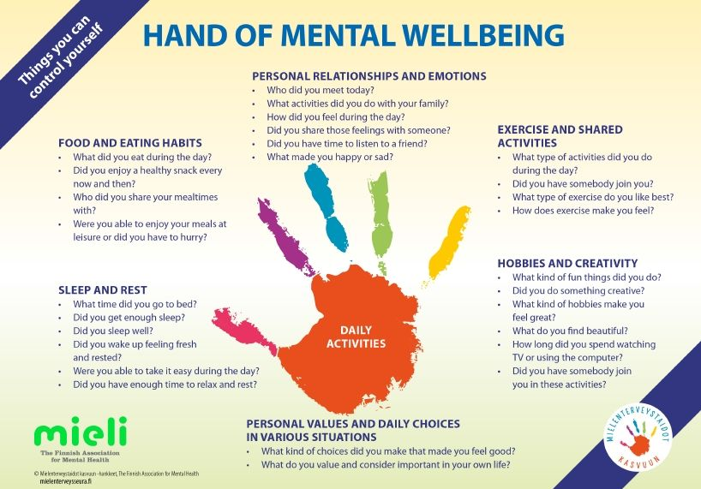
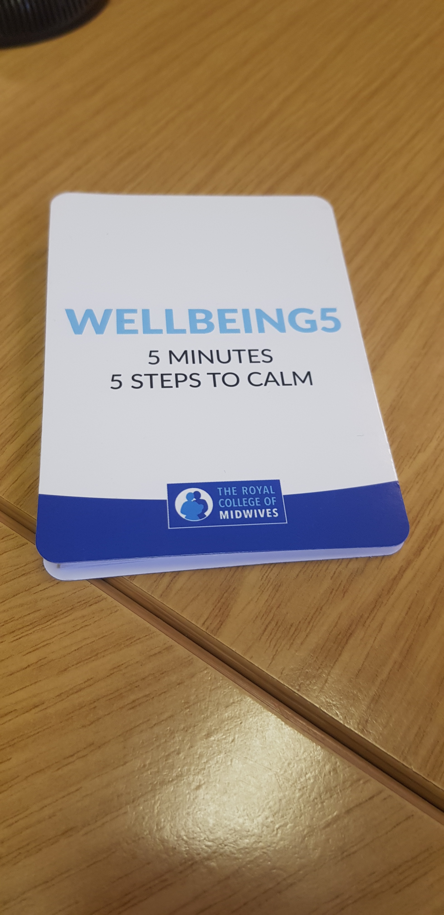
Reducing Stress
Notes:
introduce the Wellbeing 5 mindfulness script – it was developed by two community midwives in Edinburgh, they use it at the start of each day – different members of the team can read the script each day. Then I read the script and get them to do it.

Slide 34

Ideas!
Ten at Ten
‘Wellbeing Five’ – mindfulness at start of shift
Thank yous at end of shift – specific – up, across and down
Shared fund raising
Lunchtime walks
Staff wellbeing sessions – massage / meditation
360s
Asking for ideas and putting some into practice
Notes:
We need to start with ourselves – put ourselves in the best state to cope with what life and work throws at us

Slide 35
Developing agreed standards of behaviour
Notes:
This is the agreed standard of behaviours that have been co produced by the maternity team at a London maternity unit that had a problematic culture – all staff have signed up and there is a clear process if they are not behaving in ways that are consistent

Slide 36

Developing a local plan
What core values would you like to agree and demonstrate as a maternity team?
How can these values be demonstrated – what behaviours can everyone agree to?
Notes:
get the participants to write a positive behaviour they think should be adopted on a post it and we stick that up. I then write up all of the behaviours and send to the participants and the HoM – so they can then choose how they are going to use them – they might want to develop their own behaviours charter

Slide 37
Summary
National Focus on culture – tap into national guidance and resources
Issues in maternity – check out RCOG and RCM work on undermining and bullying on RCOG website
Strong link between cultures and safety – this is not an add on
Being Civil to colleagues is a key element of safety and creating a positive culture
Tackle directly bullying, undermining or harassment
Management focus on staffing and workload
Individual focus on self-care, wellbeing and stress reduction – rest, diet, exercise,
Team focus on team care, wellbeing and stress reduction – rest and breaks, food and drink,
Shared agreed ways of being

Slide 38


Thank you!
Website: www.rcm.org.uk
Telephone: 0300 303 0444
Email: info@rcm.org.uk
www.facebook.com/midwivesRCM
@MidwivesRCM

