Slide 1
Appraisal Workshop

Slide 2
Background
The pay progression of NHS Staff employed on Agenda for Change terms and conditions is conditional upon them demonstrating that they have the knowledge and skills/competencies for their role.
The appraisal meeting will be used to assess their knowledge and skills/competencies against a profile for that pay increment. In Scotland, Wales and Northern Ireland the Knowledge and Skills Framework (KSF) will be used. In England employers, in agreement with NHS Trade Unions, can use an alternative competency framework.

Slide 3
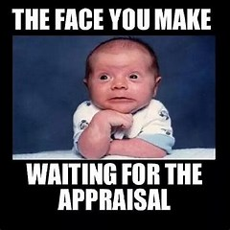
Learning outcomes
the case for appraisal
essential preparation for your appraisal
what to expect during the appraisal meeting
making the appraisal a partnership
agreeing performance objectives
personal development planning
what to expect after the appraisal meeting

Slide 4

Groupwork
In groups think of as many reasons why appraisals are important.

Slide 5

Your appraisal understanding.
Have a clear understanding of my role and the part I play within the team and organisation
Have an agreed set of priorities and objectives for my work
Possess and apply the knowledge and skills I need to perform that role effectively and to achieve my objectives
Think back to your past experiences of undergoing an appraisal – either within the NHS or at another organisation in which you have worked. Create a list of the things that created a positive experience for you and the things that made it less positive – try to be as descriptive as possible.
With the benefit of hindsight, what did you do to contribute to either the positive or negative experience? Were you an equal party to the appraisal or were you just the recipient of it?
Notes:
Appraisal plays a very important role in aligning the performance and development of all NHS staff in order to ensure that the service delivers high quality patient care by ensuring that every member of staff:
Has a clear understanding of their role and the part they play within their team and organisation
Has an agreed set of priorities and objectives for their work
Possesses and applies the knowledge and skills they need to perform their role effectively and to achieve their objectives

Slide 6
NHS Knowledge and Skills Framework
The NHS Knowledge and Skills Framework (KSF) is a tool that is used to describe the knowledge and skills you need to apply at work in order to deliver high quality services and includes an annual system of review and development for all staff covered by Agenda for Change contracts.
You will typically have annual development reviews against your KSF post outline that will result in the production of your personal development plan.
Your line manager will work with you to agree development plans and then to enable you to fulfil what is in them. Your manager will encourage you to progress and develop and where training and/or development needs have been identified and agreed, they will ensure sufficient financial support is provided.

Slide 7
Benefits for you from a successful review should include
Receiving recognition and support from management as you develop in your work role
Being reminded of how you are contributing to the quality of service of your unit
Having the opportunity to have your views and suggestions heard relating to both your own development and that of the overall unit
At the same time, the benefits to your organisation from a successful review should include:
Clearer understanding of organisational goals by all staff
Stronger working relationships between the manager and staff
Improved organisational productivity as a result of discussing individual performance issues
Objectivity in decision making concerning promotions, training, and other personnel actions

Slide 8
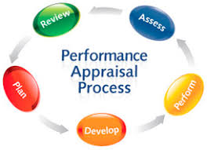
Your appraisal
Rule number one is to be ready on time for the interview! You should have been given uninterrupted time for the meeting.
Think of how you have preformed since your last meeting and be ready with an answer to the question.
Greet your manager in a positive way.
Structure your conversation remember to begin and end on a positive this way the managers are more likely to remember this.

Slide 9
Structure of the interview
Initial discussion – Agreeing what the purpose of the meeting is and what you each hope to achieve. Sharing each other’s objectives with regard to the discussions
Review of past year’s objectives/development plan – Conducting a thorough review of your progress during the appraisal period
Objective setting – Agreeing performance standards and objectives for the next year
Personal Development Plan – Discussing development activities for you to undertake
Summary – Reaching a conclusion on what has been discussed and what will happen next

Slide 10

Group work
Get into groups and think about 4 tough questions that your manager may ask you?

Slide 11
Receiving feedback
A good appraisal interview should be rich in feedback – with an honest and direct discussion on areas of strength and areas where performance needs to improve.
It is generally fair to say that very few people really enjoy receiving feedback - nobody likes being told what they are doing is wrong and perversely people are often equally uncomfortable when discussing areas where they did well.
Feedback helps us to stop, think and learn how to do things differently so we remain effective in our role, focused on the right things and motivated to continue to develop our capabilities.
It is important that the process of giving and receiving feedback is handled correctly. When handled badly, it can lead to frustration, anger and ill feeling between colleagues.
How do you reactive to feedback whether it is positive or negative?

Slide 12
Top tips
Take a deep breath
It is all too easy to go on the defensive when receiving feedback so take a moment for a deep breath and to think about what you have just been told. Remember that feedback is provided to help you to develop.
Try to remain cool
If you find this hard, just ask for a moment to compose yourself.
Accept it
Sometimes it needs someone looking in from the outside to make us aware of potentially positive or negative aspects of performance. Accept the fact that others may see something that you do not see and try to learn from their perspective.
Ask questions
The feedback should ideally include suggestions on how you can maintain a strong performance or address weaknesses. If no suggestions are made, ask for some.
Learn from it

Slide 13
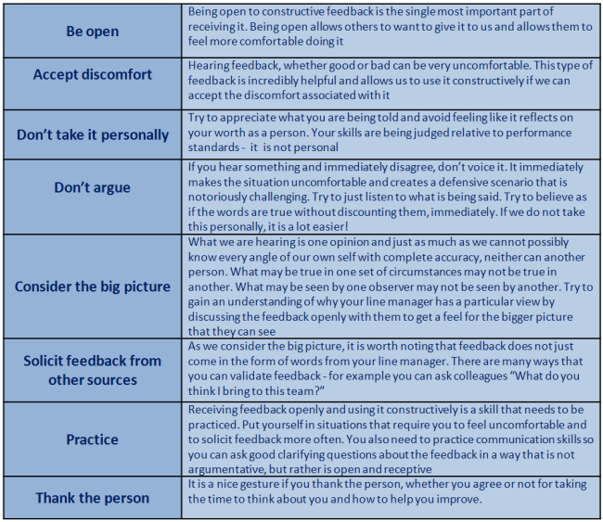

Slide 14
Managers will use SMART objectives
To be SMART, objectives should be:-
Specific – Clearly expressed in terms of the specific results you want to achieve. Making the objective measurable helps ensure that it is specific. (The activities needed to achieve the objective should also be agreed)
Measurable – You should be able to measure the attainment of the objective. Measures can be related to rate, frequency, number or percentage. What system is in place to track the progress towards attainment?
Achievable – The objective agreed must be capable of being completed successfully. Consider whether this can be done in the timeframe with the resources available?
Realistic/Resources - With the resources available (include money, skills, equipment, time) - is it possible to achieve this objective?
Timed – An achievable and realistic deadline is required to measure achievement of the objective

Slide 15
Appraisal discussion
This discussion should be based on:
Agreement on the type and level of knowledge and skill required to carry out your job successfully so that you achieve the agreed job objectives
A mutual understanding of the levels of skill and knowledge you have actually displayed during the previous year
An assessment of whether you have displayed the required levels of skills and knowledge demanded by your performance objectives in the next year
Planning development actions such as training or work experience to address identified shortfalls or gaps in the required skills and knowledge
Prioritising this development in terms of which is the most important e.g. mandatory training, development required for the job and training that you would value for your own personal development

Slide 16
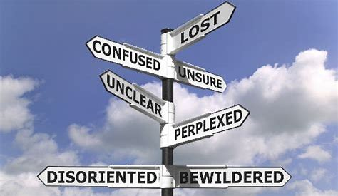
After the appraisal
If you walk away from your appraisal unhappy or confused about some of the feedback you have received, after you have had some time to think over what was discussed ask to speak to your line manager again to clarify certain points from your appraisal.

Slide 17
After the appraisal
If you had some negative feedback, take this as an opportunity to devote some time in developing those skills. Speak to your line manager or HR department about formal training programmes, coaching or if there is any in-house training that can help you. An employee who is willing to take even seemingly short-term steps towards investing in their personal development will reap the rewards longer term in their future career.
Finally, remember that appraisals are not a once-a-year occurrence, but rather an on-going process. Keep a record of things you have done and projects you have worked on throughout the year so that you can review these and have it to hand for your next appraisal. i-folio provides a great opportunity to efficiently keep all your records and reflection in one place.

Slide 18
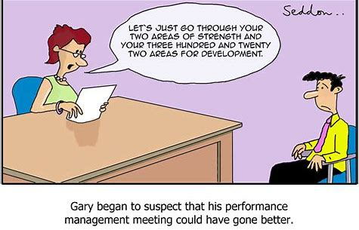
Review the appraisal itself
To what extent where my objectives/outcomes for the interview met?
What worked well in the interview and contributed to its success?
What would have made it easier/even better?
What did not work well and I should look to avoid in future?
What are the key points I have learnt from this interview to help me improve the next one?

Slide 19
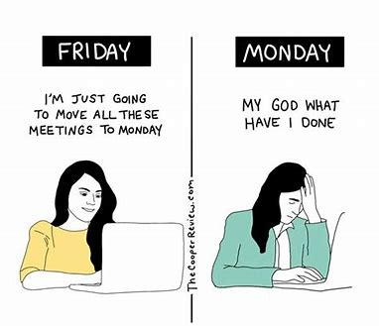
Following your meeting you should be given a copy of your appraisal documentation
The performance review process is literally that – a process. To be effective, it should not be just down to holding an interview and then nothing more for 12 months. There needs to be a continuing thread between the two events so that you can demonstrate continuing achievements that can be recognised. Seek regular feedback from your manager

Slide 20


For further information
Website: www.rcm.org.uk
Telephone: 0300 303 0444
Email: info@rcm.org.uk
www.facebook.com/midwivesRCM
@MidwivesRCM

